Slide 1
How did early settlers’ live shape their worldview?
Roger Liu

Slide 2
Plan for today
Literary news: Nobel Laureate
Colonial America Culture Fair
Analysis of the colonial worldview: circles
Comparative reading: indigenous literatures in Taiwan and the US
End-of-class reflection

Slide 3
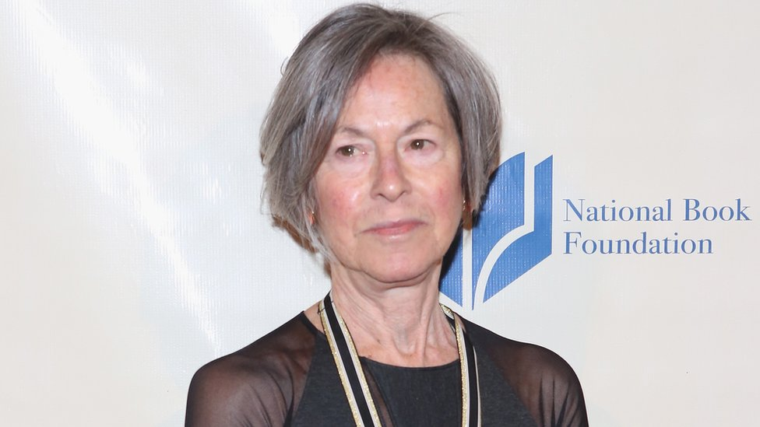
Louise Glück
born in New York City on April 22, 1943
won the 2014 National Book Award in Poetry
.

Slide 4
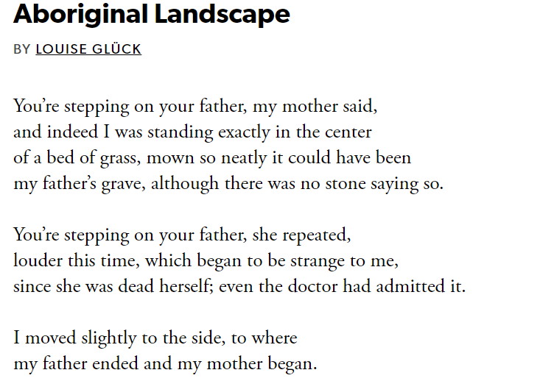

Slide 5
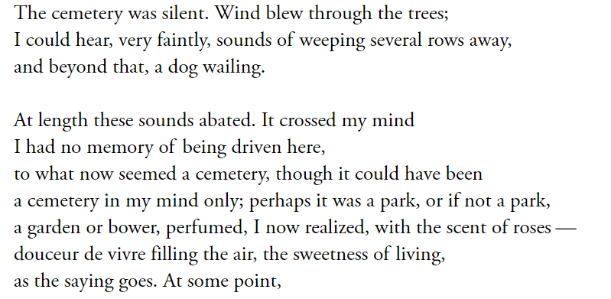

Slide 6
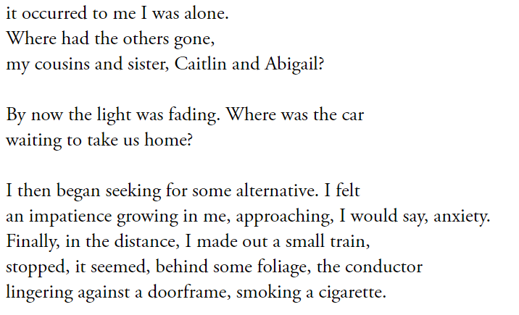

Slide 7
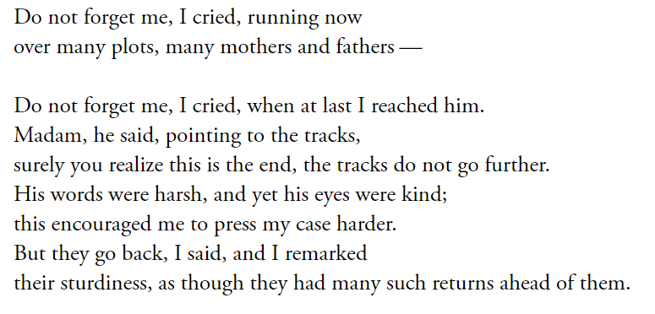

Slide 8
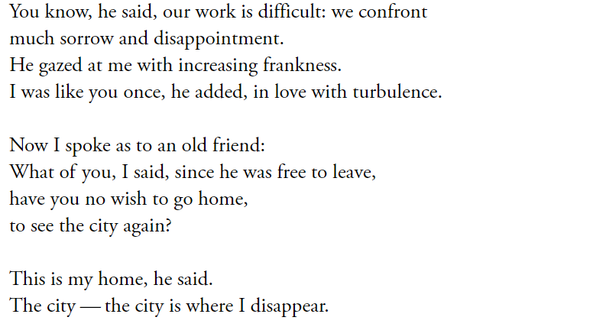

Slide 9
Colonial America: Culture Fair

Slide 10
Culture Fair
Time: 10~12 mins
Rounds: 3
Activity: take turns visiting each stand and learn from fellow students

Slide 11
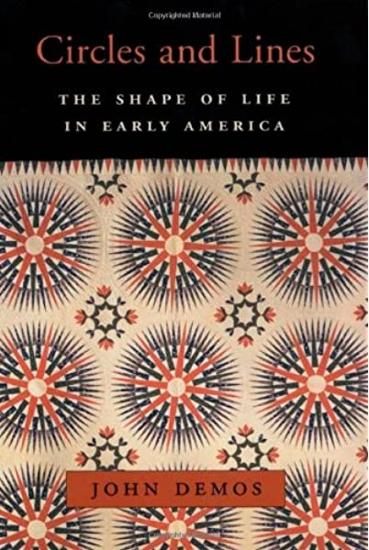
Culture Fair analysis
How did early settlers’ life shape their worldview?
John Demos
Received PhD from Harvard
Taught history at Yale
Won the Bancroft Prize
Descended from John Putnam Senior of the Salem Witch Trials

Slide 12
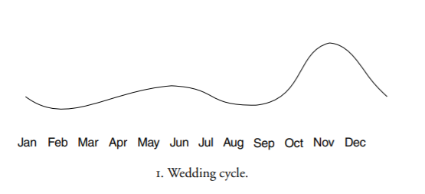
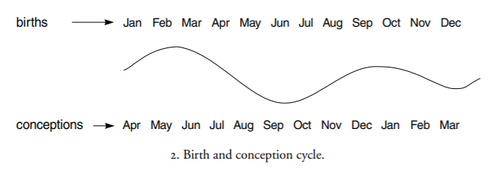
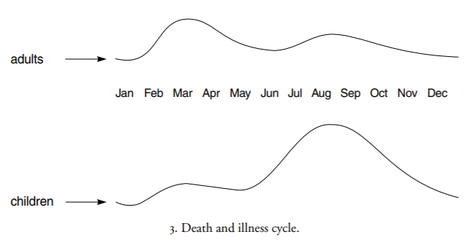
Culture Fair analysis
How did early settlers’ life shape their worldview?
John Demos
Early settlers’ life was largely determined by natural circles
American Revolutionary was the turning point (“revolve” → new)
Liberalism (as opposed to Republicanism) brought in the linear view of progress

Slide 13
Comparative reading: Taiwan and the US

Slide 14
Indigenous Literatures
Between Taiwan and the U.S.
Joy Harjo
Incumbent United States Poet Laureate
Member of the self-governed Muscogee (Creek) Nation in Oklahoma
MFA from University of Iowa’s Creative Writing Program

Slide 15
Indigenous Literatures
Between Taiwan and the U.S.
Joy Harjo
“The Flood” (1994)
Read the story and try to find the three female characters

Slide 16
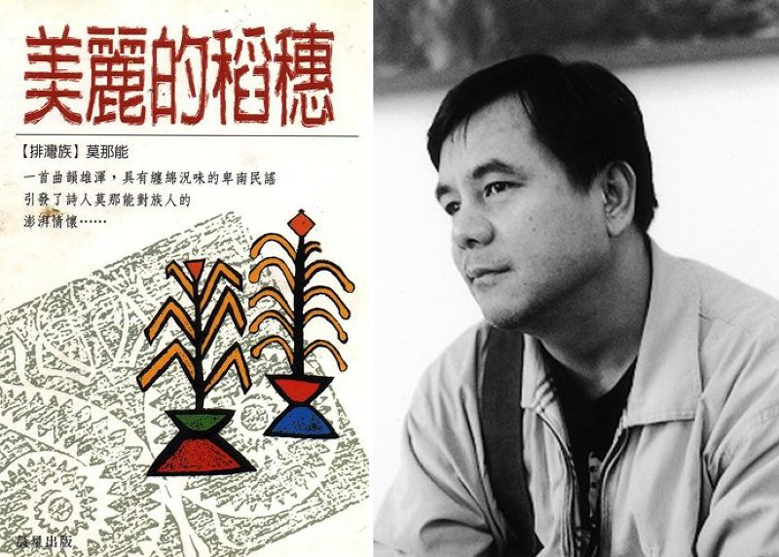
Indigenous Literatures
Between Taiwan and the U.S.
Monaneng 莫那能
馬列雅弗斯·莫那能（Malieyafusi Monaneng，1956年6月3日－），臺灣原住民族排灣族詩人，臺東縣達仁鄉人，世稱莫那能，曾用漢名曾舜旺
莫那能年輕時曾經考上空軍機械學校，但是因為視力問題無法就讀。為了負擔家計，莫那能離開家鄉，到外地的大城市中工作，做過砂石工、捆工、搬運工、屍體清洗工
1979年，莫那能因車禍腦震盪，在醫院昏迷了將近兩個月，醒來的時候右眼全盲、左眼視力0.2；全盲後的莫那能，在臺灣盲人重建院習得按摩技能，並在陳映真鼓勵下用點字寫作
https://www.storm.mg/article/54573?page=2
https://zh.wikipedia.org/wiki/%E8%8E%AB%E9%82%A3%E8%83%BD

Slide 17
“The Hundred-Pacer Snake is Dead” (1989)
The hundred-pacer snake is dead
Stuck in a transparent bottle of medicinal wine
The label on the bottle reads: Aphrodisiac
A teaser for the guys roaming the red-light district
The hundred-pacer snake of myth is dead too
The Paiwan people once believed its eggs were their ancestors
But today it sits in a transparent bottle
Now the agent for promoting lust in the big city
When a man drinks the medicinal wine
And struts his false majesty into the red-light district
There, at the brothel door to meet him,
Is the descendent of the hundred-pacer snake:
A young Paiwan girl

Slide 18
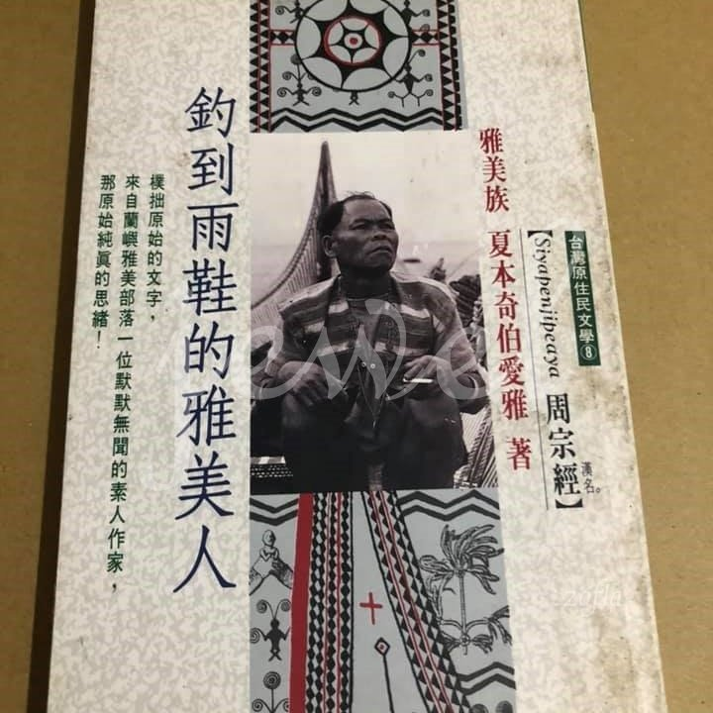
Indigenous Literatures
Between Taiwan and the US
Siyapenjipeaya 周宗經
周宗經是雅美族文學家，其著作有《雅美族的古謠與文化》夏本奇伯愛雅〈周宗經〉著，常民文化，1996；《雅美族的社會與風俗》夏本奇伯愛雅〈周宗經〉著，臺原(吳氏總經銷)，1994；《釣到雨鞋的雅美人》周宗經著，晨星，1992；《三條飛魚》周宗經著，遠流，2004；《雅美族神話故事》周宗經文，中華兒童叢書出版，1996。

Slide 19
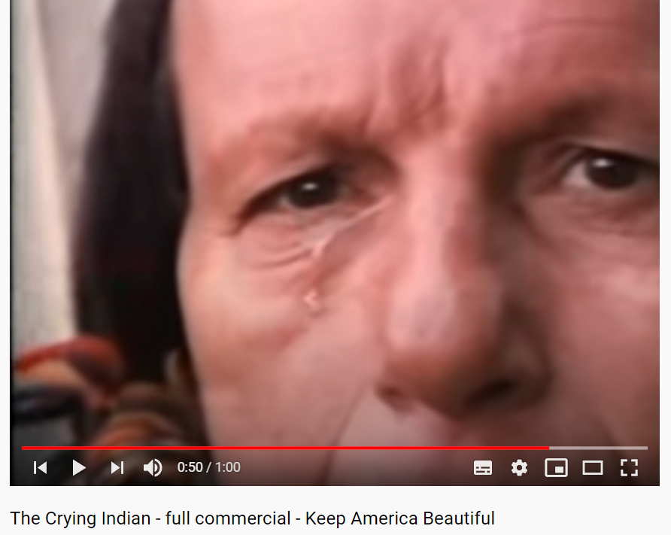
Indigenous Peoples in Popular Culture
Between Taiwan and the U.S.
https://youtu.be/j7OHG7tHrNM

