Slide 1
Is Taylor’s and Edwards’ God the Same?
Roger Liu

Slide 2
1. Peer Teaching: Taylor and Edwards 2. Activity: Introduction to Rogerology 3. Lecture: The (First) Great Awakening
Plan for today

Slide 3
Peer Teaching

Slide 4
Round One
Get together with students who read the same excerpt (2-3 people in a group).
Share notes, communicate ideas, ask questions.

Slide 5
Round Two
Exchange group members.
Follow the steps:
Team A starts by stating the main point of the reading and offer examples from the notes.
Team B takes notes, ask questions, and tries to give a summary of Team A’s presentation.
Team B repeats step one.

Slide 6
Round Three
Each group will go to Google document to share four things:
One similarity between the two readings
One difference between the two readings
One interesting observation/fact
One question that bothers you

Slide 7
Edward Taylor (1642-1729)
A minister of the Congregational church at Westfield, Massachusetts for over 50 years
Work: Preparatory Meditations before my Approach to the Lord’s Supper. Chiefly upon the Doctrine preached upon the Day of Administration [of Communion] (written 1682–1725)

Slide 8
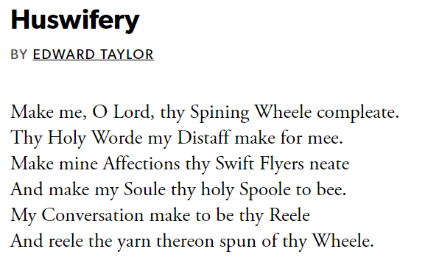

Slide 9
https://youtu.be/RleG5oifdRo

Slide 10
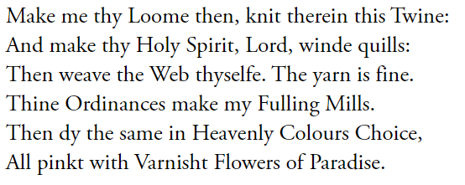
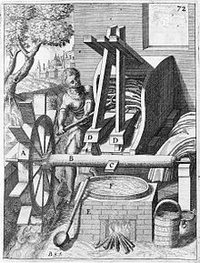
Fulling: cleansing of cloth (particularly wool) to eliminate oils, dirt, and other impurities
https://en.wikipedia.org/wiki/Fulling

Slide 11
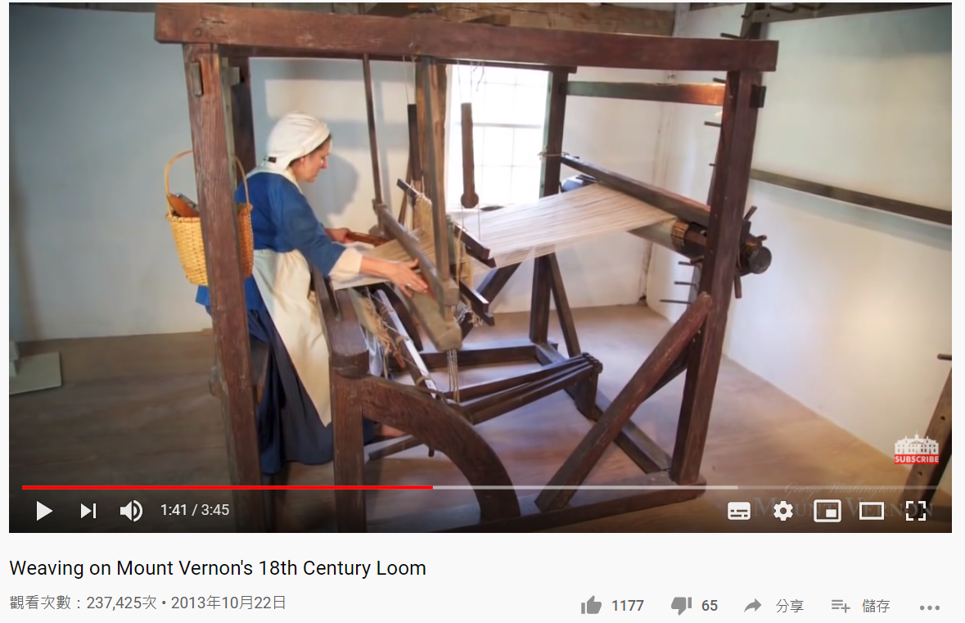
https://youtu.be/FnbUF0wgIfw

Slide 12
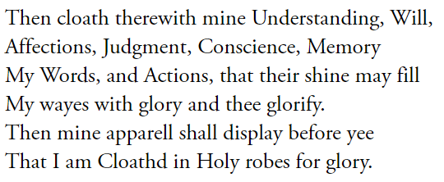
https://slideplayer.com/slide/14021104/

Slide 13
Jonathan Edwards (1703-1758)
preacher, philosopher, and Congregationalist Protestant theologian: justification by faith
First Great Awakening (1730-1755)
died from a smallpox inoculation shortly after beginning the presidency at the College of New Jersey (Princeton U.) → to persuade his “superstitious” students

Slide 14
https://edsitement.neh.gov/lesson-plans/lesson-1-first-great-awakening

Slide 15
https://pixabay.com/photos/fire-background-flame-black-hot-1008926/

Slide 16
https://arrangedrecords.com/art/final-destination-5/

Slide 17
Activity: Introduction to Rogerology

Slide 18
Introduction to Rogerology
Rogerology is the doctrine of a new religious movement that centers on a teacher of American literature.
Try to come up with:
The way they worship
Their ideas about life
and how to promote this belief.

Slide 19
Lecture: The (First) Great Awakening

Slide 20
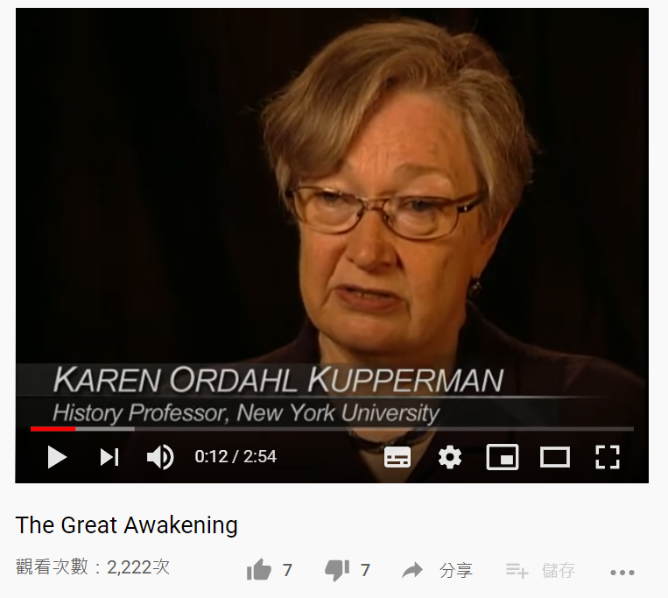
https://youtu.be/nrbUWqOotw0

Slide 21
The (First) Great Awakening
Basics:
1730-1755
Reaction to the Enlightenment
Key figures:
Jonathan Edwards (1703-58)
George Whitefield (1714-70)

Slide 22
Background
Conflicts between scientific discoveries and Christian belief
They argue: God’s created world can be rationally understood by humans (the world functions so well → gotta be a divine creator) c.f. Bradford/Winthrop and Edward Taylor
Deists: Those who believe in a God-like existence
The Enlightenment

Slide 23
Background
The Enlightenment is also about how the society can function smoothly. (c.f. Edward Taylor’s inward-searching)
They argue: Humans are basically good (c.f. original sin) and are bound by their common humanity
Tabula rasa (wax tablet): experience makes you who you are (social and good)
The Enlightenment

Slide 24
Common humanity: sympathy (we can rationally understand the pain people are suffering)
Two things are picked up by the revivalists:
emotion (joy/sorrow)
race (Indian converts)

Slide 25
Key figures
Jonathan Edwards
a lot of emotions in his sermons (fear/pain)
a lot of emotions in his religious experiences (joyful tears) → common to the converts of the time
The Great Awakening

Slide 26
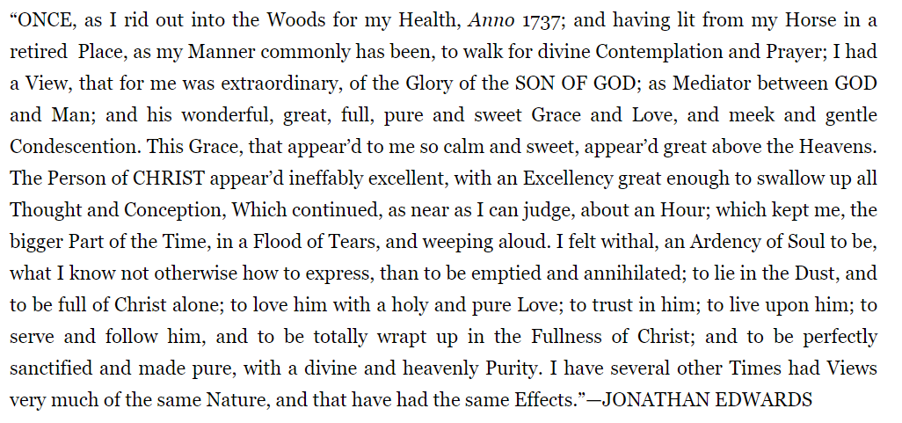

Slide 27
Key figures
George Whitefield
one of the founders of Methodism and the evangelical movement (convert people)
great preacher who did a preaching tour in the colonies
friend of the non-religious Benjamin Franklin
The Great Awakening

Slide 28
Key figures
George Whitefield
When preaching on Society Hill near Philadelphia he spoke to 6,000 in the morning and 8,000 in the evening. On the following Sunday the respective crowds were 10,000 to 25,000. At a farewell address, more than 35,000 gathered to hear him.
The Great Awakening
http://www.william-hogarth.de/GeorgeWhitefield.html

Slide 29
Key figures
George Whitefield
Once Franklin emptied his pockets at home, knowing that an offering would be taken. But it was to no avail. So powerful was the appeal at Whitefield's meeting that Franklin ended up borrowing money from a stranger sitting nearby to put in the plate!
The Great Awakening
http://www.william-hogarth.de/GeorgeWhitefield.html

Slide 30
Key figures
George Whitefield
First to preach to slaves (Phillis Wheatley wrote a poem in his memory after he died, while she was still a slave)
friend of Samson Occom
statue in Upenn about to be removed for his advocacy for slavery
The Great Awakening

Slide 31
The (First) Great Awakening
Criticisms:
Too much emotion
The revivalists are just like Anne Hutchinson (intimate connections with God)
Results:
People gradually accepted the fact that different sects exist.

Slide 32
Large Image Slide
Is Taylor and Edwards’ God the same?

